Slide 1
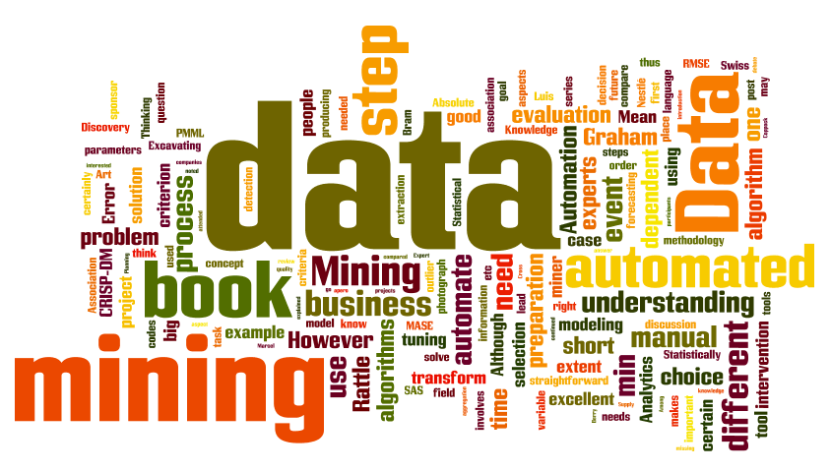
IT-533: Data Mining
Week 15
Sonja Streuber

Slide 2
Agenda
# | Topic | Reading | Due Sunday 11:59 pm CST on Blackboard
15 | Applications in Data Mining: Ethics and Electronic Profiling Course Summary Practice Final | YouTube Videos as posted on Blackboard Lei Xu et al., “Information Security in Big Data: Privacy and Data Mining.” IEEE Explore. 9/21/2014. Ellen Rooney Martin, “The Ethics of Big Data,” Forbes. 3/27/2015 | MW IC Lab 6: F: HWQ15 (TEAM): Solve an ethics question

Slide 3
Data Mining and Ethics
Data mining is frequently used to discriminate—who gets the loan, who gets the special offer, etc.
Protected groups under US federal law: Race, ethnicity, nationality, religion, sexual orientation
BUT 85% of Americans can be identified from just zip code, birth date and sex
For example, people frequently live in zip codes that are associated with particular ethnic identities → be careful when building zip code-based models; they may be based on race
Context makes a difference:
In medicine, 18 identifying attributes must be removed if records are used for analytical purposes
BUT: What if we find that some diseases are correlated to sex or race?

Slide 4
Welcome Back! Data Mining and Ethics
Who is allowed to access the data?
?
What kind of conclusions can be legitimately drawn from it?
Who collected the data?
For what purpose was the data collected?
What data protection legislation can you find on the internet?

Slide 5
Lab 1

Slide 6

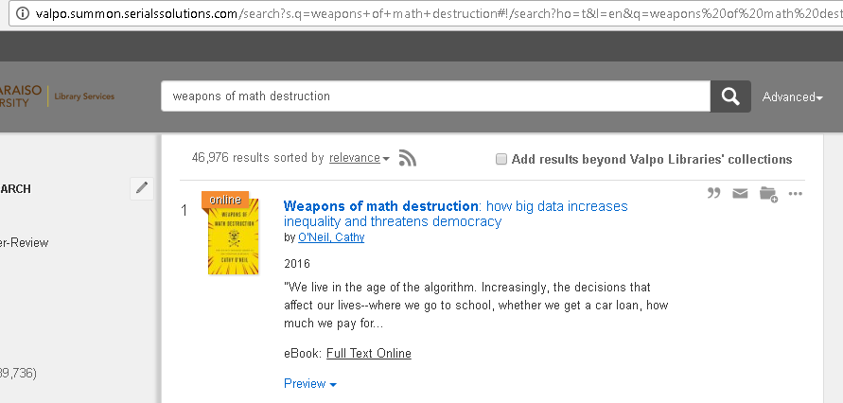
Lab 1: Data Mining and Ethics
http://library.valpo.edu
weapons of math destruction
CH 4: Propaganda Machine: Online Advertising
CH 5: Civilian Casualties: Justice in the Age of Big Data
CH 6: Ineligible to Serve: Getting a Job
CH 7: Sweating Bullets: On the Job
CH 8: Collateral Damage: Landing Credit
CH 9: No Safe Zone: Getting Insurance
CH 10: The Targeted Citizen: Civic Life

Slide 7
Lab 1: Data Mining and Ethics
Read the chapter assigned to your group, then think about the following questions:
What are the most common practices in big data that raise concern?
What has gone wrong?
How can the situation be fixed?
Research data protection legislation in your country of origin. How would you answer questions 1-3 now?

Slide 8
In Class Lab 6

Slide 9
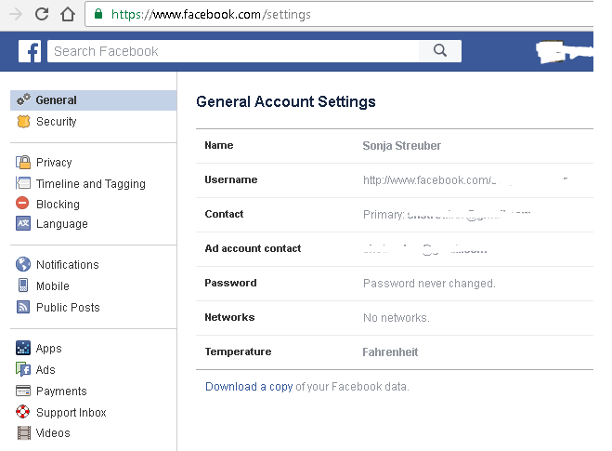
In Class Lab 6: Facebook
Check out https://www.facebook.com/help/405183566203254/
Download your data.
Answer the following two questions:
How much data did you download?
For what purposes could the following entities use these data?
A future employer
A graduate school
An advertiser for online certifications
A hacker

Slide 10
Course summary

Slide 11
Learning Objectives
Learning Objectives
Students who successfully complete this course will gain a strategic and analytical toolkit essential to Data Mining. Students will be able to:
Learning Objectives
Students who successfully complete this course will gain a strategic and analytical toolkit essential to Data Mining. Students will be able to:
Analyze large sets of data and uncover patterns within the data
Use mathematical algorithms to uncover patterns in both web and regular data
Predict data based on the patterns discovered previously
Use tools and statistical analysis to analyze data, including MS Excel, R, Python, and h2o
Apply the learned techniques to many common data mining problems, such as text analytics, security, recommender systems, and more
Describe legal, ethical and public relations implications of data mining

Slide 12
Topics Covered
Big Data and Statistics (incl. Correlation, Regression, Chi Square, ANOVA) with MS Excel
Data, Databases, and Data Warehouses and Basic Statistics with R
Preprocessing: Data Preparation for Data Mining
Patterns, Associations, Correlations: Apriori, Frequent Pattern Growth, Support and Confidence Measures, Measures of Interestingness
Classification and Prediction: Decision Trees; Naïve Bayes, kNearest Neighbor, Generalized Linear Models, Ensemble Learning, Neural Networks/ Deep Learning, Random Forest
Clustering: kMeans, Hierarchical Clustering, DBScan
Applications in Data Mining: Search Engines and Text Retrieval with Python
Applications in Data Mining: Social Network Mining
Applications in Data Mining: Big Data Processing and MapReduce
Applications in Data Mining: Security—networking and banking
Applications in Data Mining: Ethics and Electronic Profiling

Slide 13
Assignments Done
On the course Blackboard.

Slide 14
Learning Objectives
Learning Objectives
Students who successfully complete this course will gain a strategic and analytical toolkit essential to Data Mining. Students will be able to:
Learning Objectives
Students who successfully complete this course will gain a strategic and analytical toolkit essential to Data Mining. Students will be able to:
Analyze large sets of data and uncover patterns within the data
Use mathematical algorithms to uncover patterns in both web and regular data
Predict data based on the patterns discovered previously
Use tools and statistical analysis to analyze data, including MS Excel, R, Python, and h2o
Apply the learned techniques to many common data mining problems, such as text analytics, security, recommender systems, and more
Describe legal, ethical and public relations implications of data mining

Slide 15
course FINAL
Monday, December 12, 1-3 pm in this room

Slide 16
Agenda
# | Topic | Reading | Due Sunday 11:59 pm CST on Blackboard
F | FINAL EXAM 1-3 pm | USE: Books&slides& assignments DO NOT USE: Friends, the internet, etc. | Course Final Exam, 1-3 pm CST on Blackboard.

Slide 17

Thank you!

